Slide 1
Digital Forensic Part-II COMPUTER FORENSIC INVESTIGATION PROCESS
Dr. Risala Tasin Khan
Professor
IIT, JU

Slide 2

Understanding the Forensic Investigation Process & its Importance

Slide 3
Forensic Investigation Process
Examination/Investigation Goal:
In digital forensics, the goal of examination and investigation is to uncover, preserve, and present digital evidence in a way that is scientifically valid, legally admissible, and forensically sound.
Investigators should have a clear idea about the goal of examination prior to conducting the investigation.
They should have an in depth technical understanding of the inner working of what is being examined.
They should have the capability to take a systematical approach to examine evidence based on the request made.

Slide 4
Forensic Investigation Process(Cont..)
Hypothesis Formulation/Criteria
In digital forensics, a hypothesis formulation is a logical assumption made to guide an investigation. It helps examiners form a theory about what happened, how it happened, and who was involved — and then test that theory using evidence.
Instead of randomly searching through data, investigators ask:
“What could have happened here?”
Then they build structured hypotheses to test that idea.

Slide 5
Scenario 1:
you’re investigating a suspect system to determine whether Dropbox was installed by an employee and possibly used for data exfiltration. The OS (Windows, macOS, Linux, etc.) influences where and how Dropbox leaves its traces (artifacts).
So, your hypothesis might be:
“Dropbox was installed and used on the suspect’s device to transfer confidential files.”
But that’s too vague unless it’s OS-aware.
So, during hypothesis formulation, you should refine your hypothesis like this:
“Dropbox was installed on a Windows 10 system and used on June 12th to sync confidential documents.”
Why this matters:
- Each OS stores Dropbox artifacts in different locations with different formats.
- You’ll need to frame experiments that match the OS environment and use tools suited to extract those specific traces.
🧪 In practice:
- If you formulate a hypothesis without considering the OS, you risk missing or misinterpreting artifacts.
- A solid forensic hypothesis should specify conditions like the operating system, expected file paths, and timeframe of activity—so your testing is targeted and scientifically valid.

Slide 6
Scenario 2:
Case Background:
A company suspects that an employee, Alex, has leaked confidential design documents to a competitor. The company’s security team observed unusual file transfers from Alex’s workstation to a personal USB drive and frequent late-night logins.
Digital Forensic Hypothesis:
"Alex copied proprietary design documents onto a USB drive on June 22 and sent them to a competitor via personal email using the company’s network.“

Slide 7
To Test the Hypothesis, Investigators Will:
Step | Evidence Source | Purpose
1. Examine USB Logs | System logs, registry entries | Confirm if a USB was inserted and used on June 22
2. 2. Check file access history | File System Metadata | See if confidential documents were opened or copied
3. Analyze Network Logs | Firewall/Proxy Logs | Check for connections to personal email or suspicious domains
4. Review e-mail contents | E-mail achieved (if available) | Look for attachments sent to external addresses
5. Verify timestamps and user activity | System Logs, login records | Match activity to Alex’s account during the suspicious time

Slide 8
Forensic Investigation Process(Cont..)
Experimental Design:
After hypothesis formulation, frame an experiment to test the hypothesis.
This involves:
Defining the test environment:
Set up a system that closely resembles the suspect’s device or environment.
Match OS, software versions, and configuration.
Selecting the forensic tool:
Choose validated tools (e.g., Autopsy, FTK, Magnet AXIOM) that can extract and analyze relevant artifacts.
- Use multiple tools to cross-verify results for reliability.
Identifying Variables and Controls:
Variables: What you expect to change or observe (e.g., presence of Dropbox artifacts).
- Controls: Conditions that remain constant to ensure fair testing.
Executing the Experiment:
Perform actions that simulate the suspected behavior
Collect and Analyze the Evidence:
- Examine logs, file paths, registry entries, timestamps, and metadata.
- Compare findings against the hypothesis.
Reviewing results
- Determine whether the evidence supports or refutes the hypothesis.

Slide 9
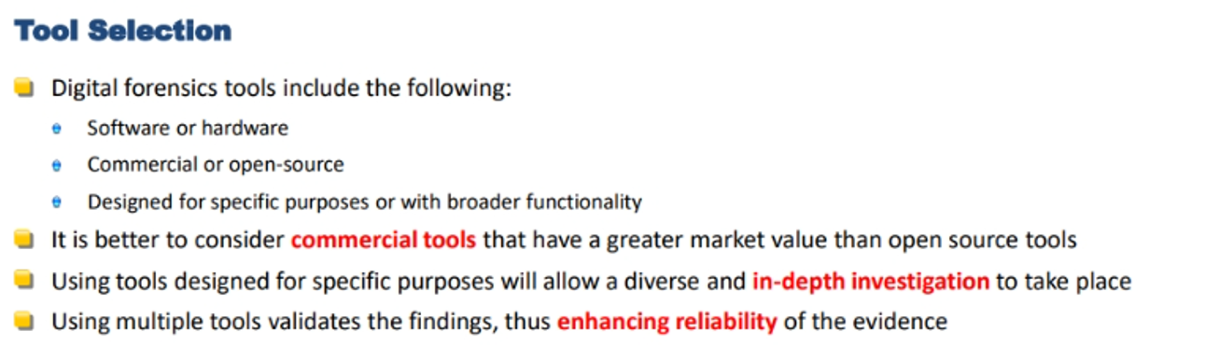
Forensic Investigation Process(Cont..)

Slide 10
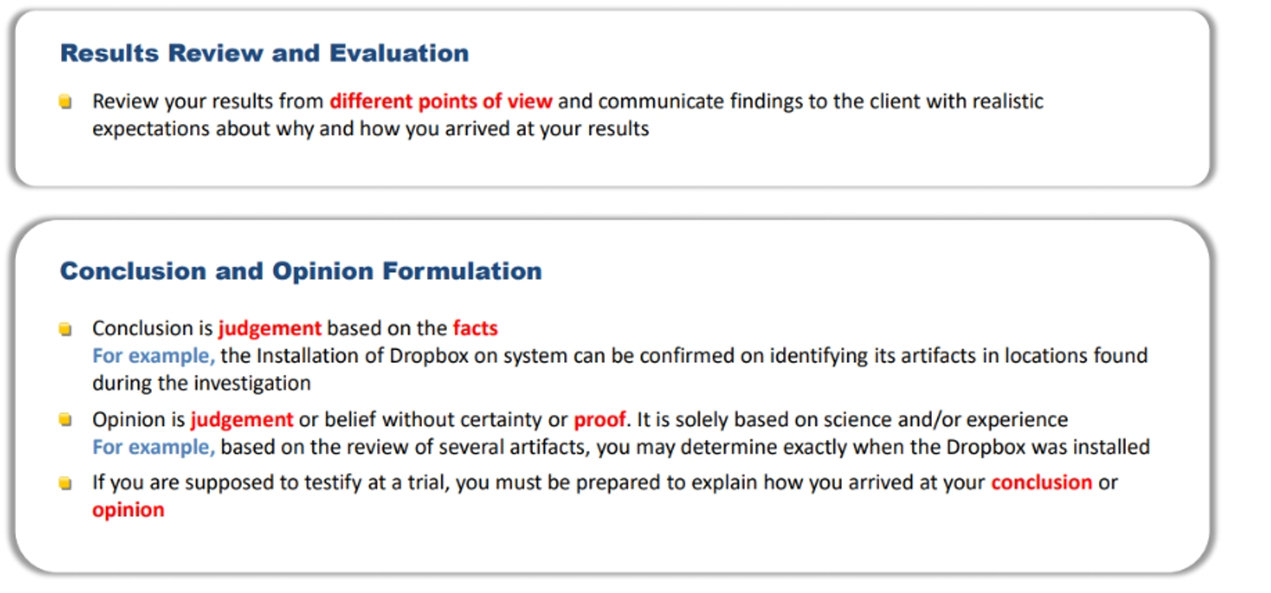
Forensic Investigation Process(Cont..)

Slide 11
Forensic Investigation Process on Scenario 2
Tool | Purpose
FTK Imager / EnCase | Disk imaging and analysis
USBDeview / Windows registry analysis | Detect USB device usage
Autopsy / X-Ways Forensics | File system analysis
Email forensic tools (e.g., MailXaminer) | Email content recovery
Wireshark / Network logs | Inspect network communication
Event Log Viewer | User login/session tracking
Hashing tools (MD5/SHA-1) | Ensure evidence integrity

Slide 12
Forensic Investigation Process on Scenario 2(Cont..)
Evidence Type | Source | Justification
USB device history | Windows Registry, SetupAPI logs | Determine if a USB was connected
File access metadata | NTFS file system (MFT, $LogFile) | Track access/modification times
User session logs | Event Viewer logs | Confirm user login times
Email data | Email server logs, sent mail folder | Check if files were emailed externally
Network traffic | Proxy/firewall logs, packet captures | Detect communication with outside domains
File hash comparison | Original vs copied files | Prove data duplication

Slide 13
Forensic Investigation Process on Scenario 2(Cont..)
Create a forensic image of Alex’s workstation using FTK Imager.
Examine USB connection history to detect any USB drive use on June 22.
Review file access logs for the design documents directory (look for timestamps, copying or deletion).
Analyze email client (e.g., Outlook/Thunderbird) for any messages sent externally during or after USB access.
Check network logs or proxy records to identify personal email service access (e.g., Gmail, Yahoo).
Cross-reference login sessions with the timeline of file and network activities.
Hash the design files and compare them to any copies found on USB artifacts or email attachments.

Slide 14
Steps of Forensic Investigation Process
Step One: During identification, the investigator (or investigating team) must identify what evidence is present on the device, where it is stored, and what format it is stored in.
Step Two: Preservation focuses on isolating the data, securing it, and preserving it, while creating a copy, or image, that can be analyzed and investigated. This process, also known as “imaging” a device, preserves the actual evidence in its original form, so it will be admissible in court.
Step Three: During analysis, the forensic investigator collects fragments of data (bits or pieces of digital evidence) and creates a holistic narrative of what happened during the crime (or other matter being investigated).
Step Four: During Documentation, the investigator prepares a record of the data to be presented in court (or in whatever other venue that the investigation is being resolved).
Step Five: In presentation, the investigator uses the documentation to explain the conclusions they have drawn about the event in question in a compelling manner.

Slide 15
Step One: Identification
At the start of any digital forensic investigation, the investigator must identify where evidence exists that might be pertinent to the matter being investigated.
The investigator is trying to answer basic questions at this stage.
In many senses, the identification stage is a prelude to the actual work of digital forensic investigation.
Some basic Questions need to be find out like:
Who are the key evidence-holders?
In our scenario Alex is the key evidence holder.
Where might the digital traces of this activity exist?
Alex’s workstation (hard disk)
USB registry entries and logs
Email client data or webmail logs
System event logs (Windows Event Viewer)
Network logs (firewall, proxy)
Browser history and cache
File metadata and timestamps (for identifying when/if the document was opened)

Slide 16
What devices might hold evidence related to the investigation?
Most investigations will focus on devices like computers or smartphones, both of which can contain evidence of multiple types.
However, they are not the only possible devices that can yield important information.
Others might include computer servers, network or cloud file-shares, smartwatches or other wearable technology, internet of things (IoT) devices, and more.
What types of evidence are present on the device(s) being investigated?
Naturally the type of device will dictate what evidence it could hold.
Where some devices may only hold one or two types of data, smartphones or computers can hold a multiplicity of types, including emails and text messages, web histories, application data, geolocation data, and more.
Each type of evidence might occur in a distinct format, and may need be collected according to an appropriate methodology.

Slide 17
Primary Methods of Forensic Collections
Dead-box Collection In dead-box forensics, the investigator makes an image of the entire system and analyzes its contents offline. The device is powered down (hence the term “dead-box”) and results in capture of data at rest, often by removing the device’s hard drive completely, if possible.
Live Forensics In live forensics, the investigator accesses the system or device while it is still powered on, allowing him or her to capture volatile information—or information that is stored in the devices RAM. Once the device is powered down, RAM data is lost to the investigation.
Mobile Collection Mobile collection focuses on mobile devices, such as smartphones, wearable technology like smart watches, and tablets. With the wealth of data stored on smartphones, it is essential for investigators to be able to collect data from them. Since many devices give users the capability to remotely wipe data, it is critical to store them in special evidence bags that block WiFi and cellular signals and prevent static discharges that might damage the device.

Slide 18
Step Two: Preservation
Preservation is arguably the most important step of the digital forensic process.
Since the goal of digital forensics is to construct a narrative of the event in question that will stand up in court, all evidence must be preserved in a forensically sound manner, so it will be admissible in court.
Digital evidence can be very compelling, but it is fragile, and subject to tampering.
During preservation, the investigator must isolate and protect digital evidence exactly as it was found, without alteration, so that it can later be analyzed.
There are some key best practices digital forensic investigators should take into account.
Document the steps you’re taking. You will need to be able to explain them to non-investigators at the conclusion of the investigation.
Maintain the chain of custody. It is necessary to ensure your evidence is admissible in court.
Validate the accuracy of data using hash values, the unique numeric or alphanumeric string obtained by applying a hash function to a piece of data that can serve as the fingerprint of a digital file.

Slide 19
Chain of Custody
The “chain of custody” refers to the process through which physical or digital evidence is handled during an investigation.
Proving that an item has been properly handled through an unbroken chain of custody is required for it to be legally accepted as evidence in court.
It documents how, when, and by whom items have been collected, handled, analyzed, or otherwise controlled during an investigation.
Gaps in the chain of custody can result in the evidence being inadmissible.
In the infamous OJ Simpson murder trial, a number of items of evidence, including blood samples linking Simpson to the crime scene, remained in officers’ possession for considerable amounts of time before being entered into the chain of custody by being immediately logged. This mistake allowed the defense attorneys to argue that evidence linking him to the scene could have been planted or contaminated, introducing a layer of doubt into the jurors’ minds.

Slide 20
Step Three: Analysis
While identification and preservation of evidence are essential for a successful forensic investigation, analysis is the stage of the process that truly solves the mystery.
In it, the investigator reconstructs the fragments of data and creates a holistic narrative of what happened during the crime or other matter being investigated.
Due to the volume of data present and the inability to examine it with scientific instruments, digital forensic investigators rely on their technological toolkit to conduct their investigations. During analysis, investigators strive to remain open-minded as to how to interpret the evidence they find.
As evidence accumulates, the investigator will begin to form theories of what happened during the crime or incident(s) in question, and evaluate how or whether additional evidence supports the theory.
Ultimately, they hope to develop a holistic story of what happened, when, how, and why.

Slide 21
How Investigators use Forensic Analysis Tools
Email analysis: Helps investigators extract as much data as possible from email messages and addresses.
File analysis: Analyze, index, search, track and report on file metadata and file content, enabling investigators to identify files that are relevant to an investigation.
File viewers: View the contents of multiple types of files quickly.
Internet analysis: Collect and analyze internet usage and identify patterns that may be relevant.
Mobile device analysis: Software or agents developed specifically for extracting data from mobile devices.
Registry analysis: Automatically extract information from the live registry or the raw registry files found in digital evidence and display it in an understandable format.
Network forensics: Specialized technology developed to monitor and collect data passing through a network or to access specific endpoints and collect data from them.
Decryption: Decrypt encrypted data including files of any type, emails, and other messages to view and analyze them for possible evidence.

Slide 22
Password crackers: Access data on locked devices, applications, or web-based software by breaking users’ passwords.
File restoration: Restore deleted files or data to examine the evidence they may contain.
Drive defragmentation: Decode the contents of hard drives that have been overwritten by reassembling the pieces, or fragments, of files.
Image detection: Recognize faces and flesh-tone colors, especially in child pornography and exploitation matters.
Video recognition: AI technology can automatically identify critical points of interest in evidence videos like people, weapons, and drugs, thus eliminating hours of manual video review.

Slide 23
Step Four: Documentation
Once a digital forensic investigator has completed his or her investigation and has reached a compelling conclusion, the next two phases of the process—documentation and presentation—are geared towards ensuring that those charged with acting on its results find it understandable and compelling.
That audience may ultimately be a jury in a criminal trial, an oversight board in an enterprise environment, or some other group, depending on the nature of the investigation.
Ultimately, the presentation of the findings (the final step in the investigatory process), must make it easy for listeners to visualize what happened and understand the timeline of the disparate activities involved in the wrongdoing, from planning to execution to any attempts to hide evidence or cover up the activity.
If you’ve documented the steps you’ve taken thoroughly throughout the investigation, this activity should be largely complete.
You’ll just need to curate your list of steps, so that you’re focusing on the most compelling pieces of evidence and how they fit into the timeline you’re looking to establish.
Identify these key pieces of evidence and explain in layman’s terms why they are both significant and compelling. Why do they prove the assertion you are making? What is the logical path your investigation took from uncertainty about what happened to certainty?

Slide 24
Step Five: Presentation
Once the investigation is complete, and you’ve documented the most important evidence, it’s time to present the findings to the authorities charged with determining the outcome of the investigation.
In a courtroom, a digital forensics investigator might act as an expert witness, summarizing their report and presenting the most critical pieces of evidence to the jury, while the full report is submitted as an exhibit in the courtroom.
In an internal investigation of a cyber-incident, the venue for the presentation may be an executive board meeting, a meeting of the leadership team, or simply a small group of colleagues in information security.

Slide 25
Best Practices for Presenting Investigatory Results
Review your investigation notes and documentation. You’ll want to be able to speak to the steps you took and why you took them just as much as the conclusions you’ve drawn.
Make sure you’re comfortable speaking about the chain of custody for key pieces of evidence.
Practice your testimony. Review the report you’ve assembled and make sure you’re able to dig into detail and provide supporting evidence for your conclusion.
Speak in easy to understand language, not jargon. Chances are your audience will not be made up of digital forensics experts; make sure you can make key concepts, processes, and technology clear to them.
Prepare for objections and follow-up questions. There are always two sides to a story. Whether you’re in a courtroom or in an internal investigation, the opposition will have an opportunity to make their case. If you anticipate and prepare for their statements, you will be able to speak clearly to the reasons why you disagree with that interpretation.

Slide 26
Importance of the Forensic Investigation Process
The forensic investigation process is vital because it transforms raw digital or physical evidence into credible, actionable insights that can stand up in court, guide law enforcement, and protect civil liberties.
Why it is important:
Preserve Evidence Integrity:
Ensures data isn’t altered, corrupted, or lost during collection and analysis.
Supports Legal Admissibility:
Evidence must be collected and handled according to strict protocols to be accepted in court.
Reconstruct Evidence Scientifically:
- Investigators use analysis to piece together timelines, user actions, and system states.
- This helps distinguish between intentional misconduct and accidental behavior.

Slide 27
Protect Against False Accusation:
- Objective findings can exonerate innocent individuals.
- Forensic science helps avoid reliance on unreliable witness testimony.
Enables Cross-Disciplinary Collaboration:
- Combines law, computer science, psychology, and engineering.
- Facilitates communication between investigators, attorneys, and judge

Slide 28
Understanding the Investigation Phase

